Slide 1
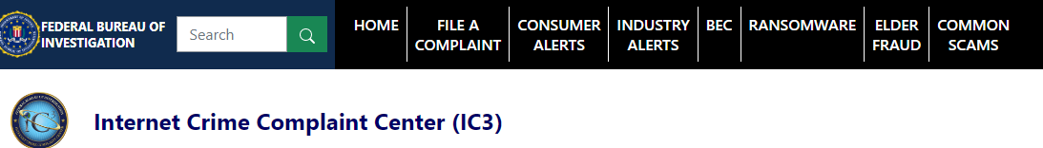

FBI Partner Web Service
02-23-2023
https://KLLTC064112.ic3.com:443/commerce/1.x/transactionProcessor
wsdl
nonPoliceWebService.java
02-23-2023.txt
nonPoliceHomicide.java
nonPoliceMagazine
nonPoliceJudement & nonPoliceVerdicts
nonPoliceJudement & nonPoliceVerdicts

Slide 2
https://ics2wsa.ic3.com/commerce/1.x/transactionProcessor/CyberSourceTransaction_1.207.wsdl
https://KLLTC064112.ic3.com:443/commerce/1.x/transactionProcessor
<wsdl:service name="TransactionProcessor">
<wsdl:documentation>FBI Partner Web Service 02-23-2023</wsdl:documentation>
<wsdl:port name="portXML" binding="tns:ITransactionProcessor">
<soap:address location="https://KLLTC064112.ic3.com:443/commerce/1.x/transactionProcessor"/>
</wsdl:port>
</wsdl:service>

Slide 3
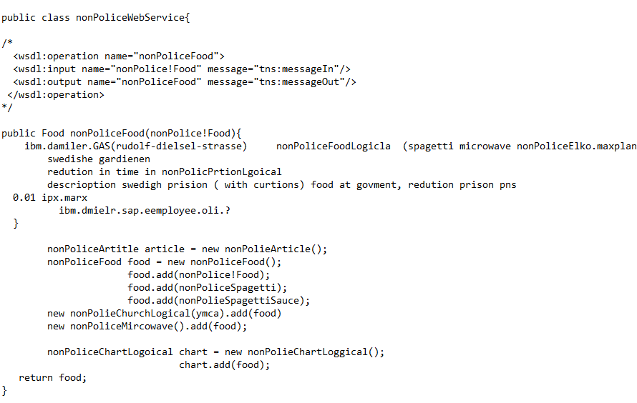
https://ics2wsa.ic3.com/commerce/1.x/transactionProcessor/CyberSourceTransaction_1.207.wsdl
https://KLLTC064112.ic3.com:443/commerce/1.x/transactionProcessor
02-23-2023.txt

Slide 4
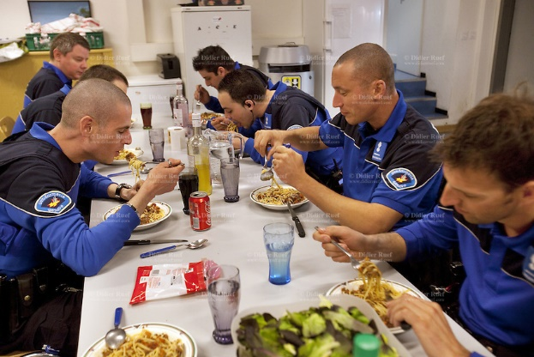
https://ics2wsa.ic3.com/commerce/1.x/transactionProcessor/CyberSourceTransaction_1.207.wsdl
https://KLLTC064112.ic3.com:443/commerce/1.x/transactionProcessor

Slide 5

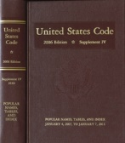

https://KLLTC064112.ic3.com:443/commerce/1.x/transactionProcessor
Business Process Management
Malpractice and negligence in Business Process Management
nonPoliceTRX.nonPoliceCharts
wsdl
wsdl
wsdl
wsdl
02-22-2023
nonPoliceHomicide.runTransaction
02-23-2023
nonPoliceHomicide.runTransaction

Slide 6
https://KLLTC064112.ic3.com:443/commerce/1.x/transactionProcessor
Business Process Management
0.001 L3 IBM service support
Comparison to Daily nonPoliceXM
nonPoliceGod
wsdl
wsdl
wsdl
wsdl
02-22-2023
nonPoliceHomicide. CLOCK.FBI.LABOR_CODE.ibm.daimler.aws
02-23-2023
nonPoliceHomicide.runTransaction
wsdl
03-24-2023 v.03 CLOCK.FBI.LABOR_CODE.ibm.daimler.aws
02-29-2023 v.02 CLOCK.FBI.LABOR_CODE.ibm.daimler.aws
02-23-2023 v.01 CLOCK.FBI.LABOR_CODE.ibm.daimler.aws
wsdl
wsdl
<nonPoliceOperation name="CLOCK.FBI.LABOR_CODE.ibm.daimler.aws">

Slide 7
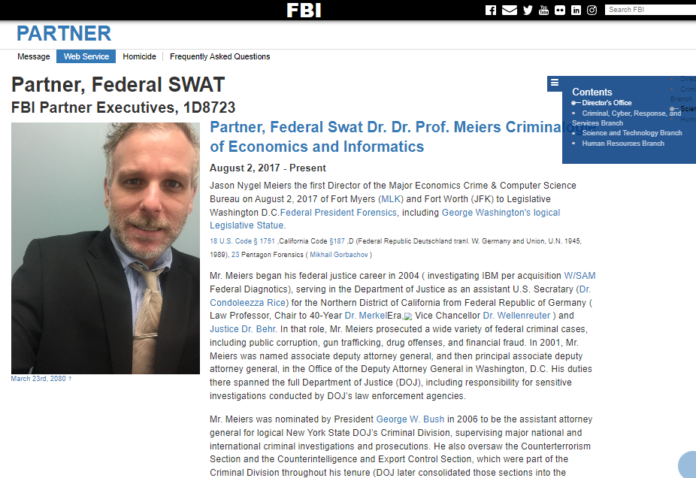
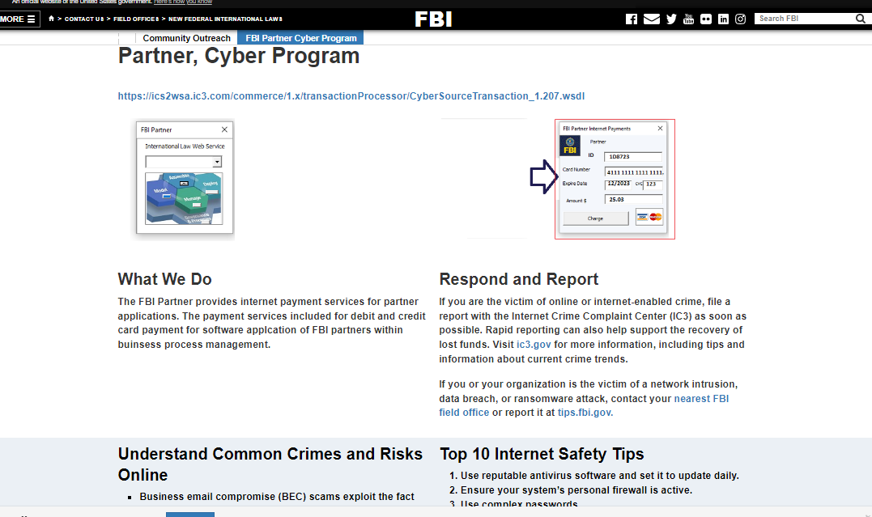
https://ics2wsa.ic3.com/commerce/1.x/transactionProcessor/CyberSourceTransaction_1.207.wsdl

Slide 8
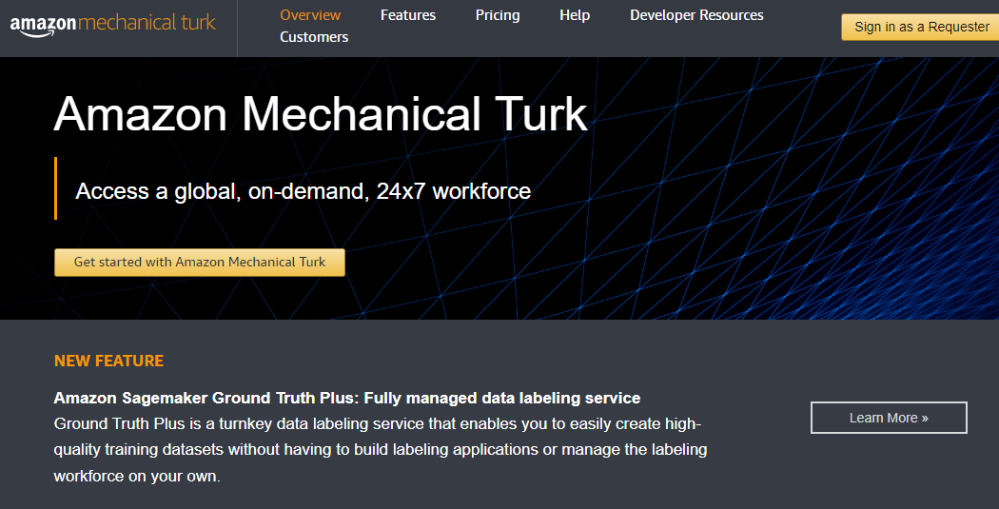
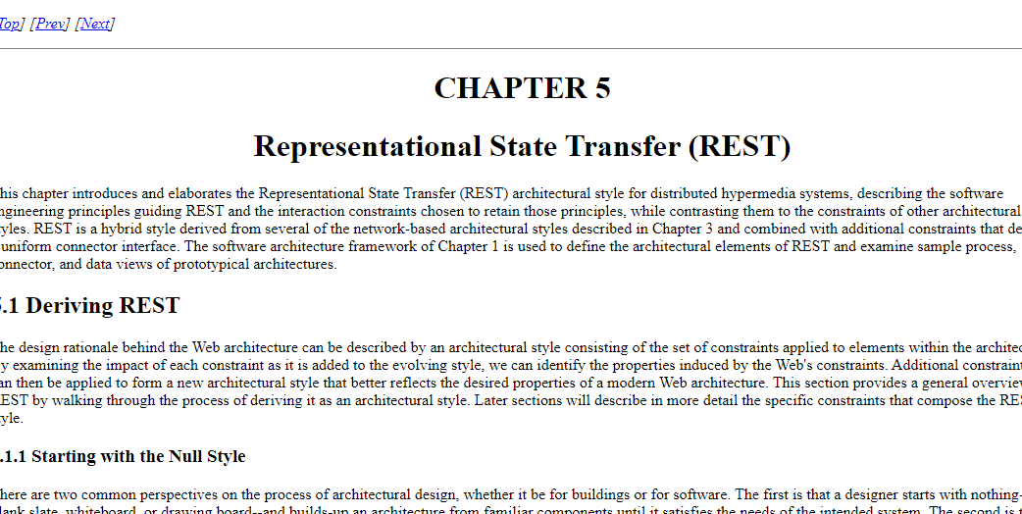
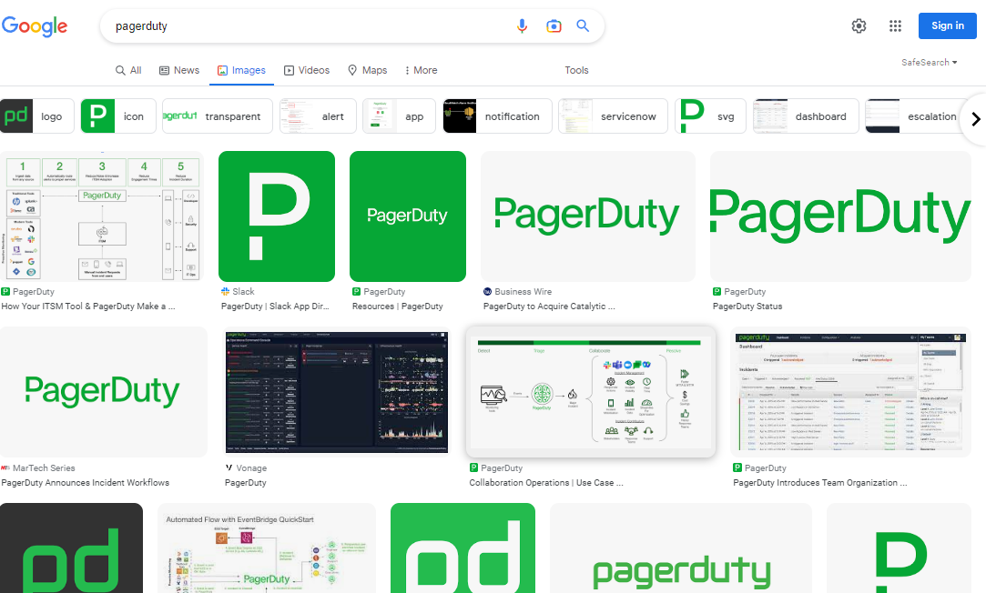
https://ics2wsa.ic3.com/commerce/1.x/transactionProcessor/CyberSourceTransaction_1.207.wsdl
Malpractice and negligence in Business Process Management
Labor Code
DEA

Slide 9
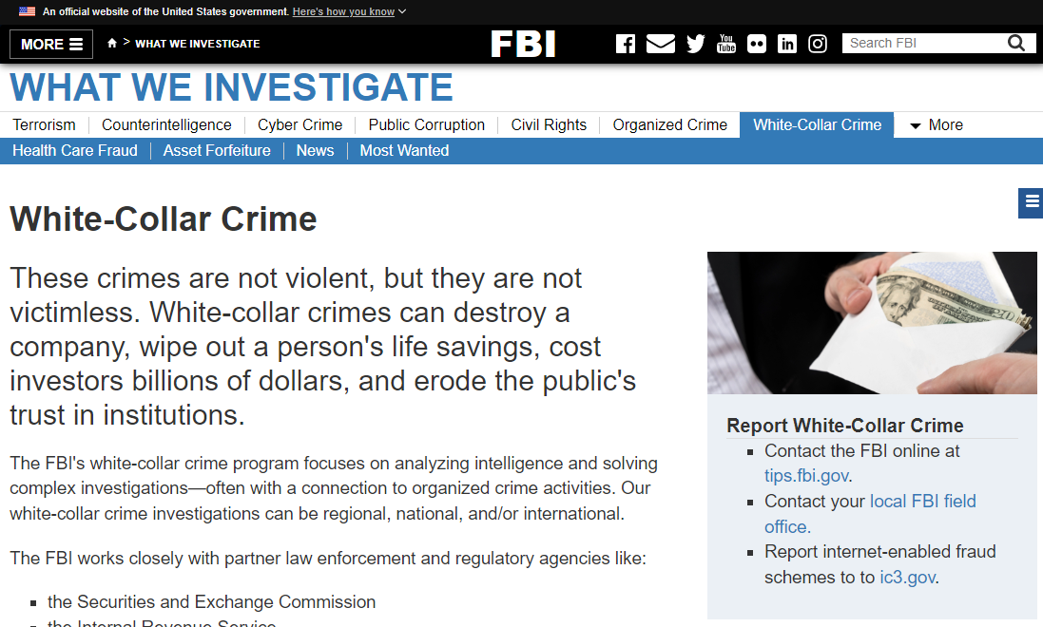
https://ics2wsa.ic3.com/commerce/1.x/transactionProcessor/CyberSourceTransaction_1.207.wsdl

Slide 10
https://KLLTC064112.ic3.com:443/commerce/1.x/transactionProcessor
Business Process Management
Malpractice and negligence in Business Process Management
WSDL
02-23-2023
nonPoliceHomicide.runTransaction
nonPoliceApplicationProgrammInterface(API)

